Slide 1
Sprint 03
TadoSoft
Team JJJ
13, July, 2011

Slide 2
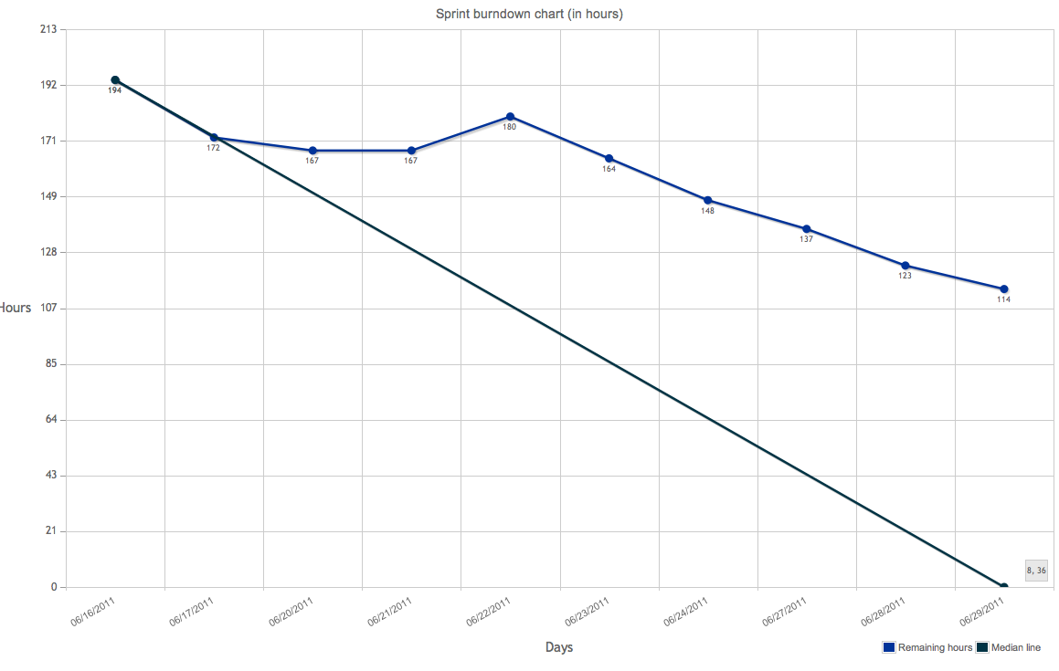
Burndown chart

Slide 3
DoD
Code
code style: Follow Xcode/Eclipse default style
complexity: <= 15 for each function (with hfcca or cyvis tool)
duplexity: <= 50 for each function (with CPD tool)
no fault
no warning
use DLog() instead of NSLog() in Obj-C
frozen version for every sprint with a GIT tag
Test
no leaks for Obj-C with XCode Instrument
Capacity&Performance test for server
unit test
Manually functional test
Document
class doc generated by Doxygen for every class, function, variable, constant with Javadoc style
design doc in word format, stored in GIT
Functional test cases(Precondition, Expect result, steps, Actual result, tester, date)

Slide 4
Committed Items
150 Facebook Login (updated)
125 Join a Krowd
160 Krowd Sorting
138 Krowdit Created Krowd
169 Krowdit Krowds
149 Password Recovery
173 JaK Krowd Expantion
134 Jak Logout
172 Jak Search

Slide 5
Code Duplexity
The CPD tool doesn’t support obj-c language. There is a 3rd-party lib, but it doesn’t work
For java language, only one warning about the same comments of Signup servlet and Login servlet, because of the same template, that can be ignored.

Slide 6
Code Complexity (objC on iPhone)
!!!! Warnings (CCN > 15) !!!!
==============================================================
NLOC CCN token function@file
--------------------------------------------------------------
86 18 270 parse@170@./Krowdit/SBJson/SBJsonStreamParser.m

Slide 7
Code Complexity (java on server)
No class >=15

Slide 8
UT
Server-side 26
iPhone 16
Test Suite 'All tests' finished at 2011-07-13 02:12:16 +0000.
Executed 16 tests, with 0 failures (0 unexpected) in 0.024 (0.077) seconds

Slide 9
Document
http://192.168.1.113/mediawiki/index.php/AcceptanceTestCase

Slide 10
Issues
http://192.168.1.113/mantis/view_all_bug_page.php

Slide 11
Q&A

Slide 12
Retrospective
Make requirement clear ASAP.
Design ATC in the beginning of sprint
Use text and diagram to help design
Personal knowledge management
Take note how the root cause of problem
Useful links is recorded on Wiki
Search more with google or App Doc Center
Debugger, memory management
AP to Jacky: training
Design Test case
AP to Ryan: training
Report bug on Mantis
AP to Fujing: report bugs for this sprint

Slide 13
Retrospective

